Slide 1
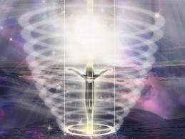
Introduction to Science of Spiritual Beings of Light
Science of Spiritual Beings of Light Lectures
Presented at Unity Church of Dallas
Oct 24, 31 - Nov 7, 14, 2011
By Doug Matzke, Ph.D.
Doug@QuantumDoug.com

Slide 2
The Nature of Spiritual Beings
We are spiritual beings…
having a physical experience!
and are more than our physical bodies!
…?
Our Spiritual Nature is real
Science can explore these spiritual foundations
We can personally explore these spiritual foundations
Understanding our Spiritual nature leads to
Better understanding of our selves
Better understanding of how we fit in the universe
Gives us a richer present and hope about our future

Slide 3
Approach for Spirited Science
Discuss continuum of physical → spiritual models
Review latest research: classical, relativity, quantum
Review non-ordinary space/time/energy/info research
Review human being space/time/energy/info behaviors
Review beings of light space/time/energy/info behaviors
Quantum dimensions are root to every ‘thing’
Models of God

Slide 4
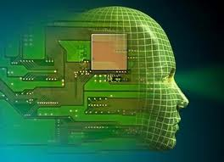
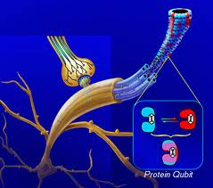
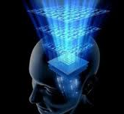
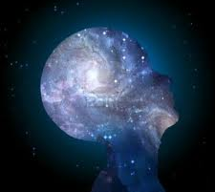
Brain/Mind/Spirit Model Continuum
Classical Brain
Mind is brain state
Dualistic Brain/Mind
Mind requires Brain
Brain is Transceiver
Quantum/Spirit Mind
Classical
Quantum
Spiritual
Brain is Computer
Neurons are Coherent
Brain is Transceiver
Self as Eternal Spirit
3d Space/ 1d Time
Matter/Energy
Locality & Conservation
Neuron Connectivity & Parallelism
Quantum State Spaces
Change without Time
Information & Probabilities
Law of Attraction & Supermind

Slide 5
What is Your Brain/Mind Model?
Classical
Quantum
Spiritual
Reality vs. Models of Reality
Data Bits vs. Knowing
Locality vs. Holographic
Sequential time vs. Eternal now
Matter/Energy vs. Information/States
Physical vs. Proto-Physical vs. Meta-Physical
Pattern Recognition vs. Attention
Consciousness vs. Subconscious
Computer vs. Supermind
Brain vs. Mind vs. Divine
Intelligence and Meaning

Slide 6
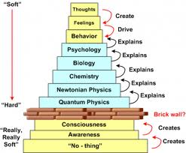
Some Models as More Useful
No-thing
Awareness
Thoughts
Feelings
Consciousness
Behavior
Quantum
Psychology
Newtonian
Neurology
Chemistry
Biology

Slide 7
Bridge between Science & Spirit
Our spiritual nature is scientifically real
Scientific techniques can be applied
Directly related to quantum theories
Revisit Western World View
Western scientists shy away for 500 years
Status quo preserved by science and religions
Theories, models & predictions lead the shift
Known in Eastern cultures for 1000s of years
Science meets Spirit
West meets East
Spirited Science is an encompassing meta-theory

Slide 8
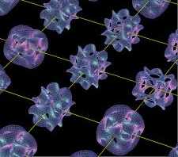
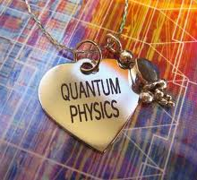
Physical & Protophysical Models
Classical Physics Properties
Matter/Energy, Mass, Space/Time
Black hole physics ties Relativity & Quantum
It from Bit, Sciences of very big and very small
Quantum Physics Properties
State Spaces, Exponential Speedup
Metaphysics and Chi Research
Non-local space/time awareness and healing states
Spiritual and Manifestation
Law of Attraction and divine states
Everything is quantized when very small, even space & time

Slide 9
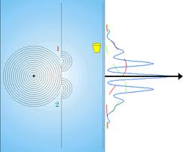
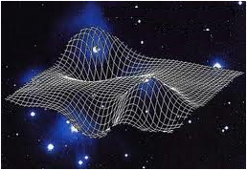
Classical Physics Properties
States of Matter
Solid, liquid, gas, plasma, atomic, quarks
Forms of Energy
Temperature, heat, complexity, thermodynamics
Chemical & nuclear bonds, phonons, photons
Potential energy, gravity, zero point energy
Space and Time
Classical space-time, computational space-time
Relativistic space-time, black hole singularity
Quantum space-time (Shor’s Algorithm)
Physical Limits
Density, heat, speed, frequency, noise, complexity, representation
Reductionist down to quantum properties

Slide 10
Information is Physical
Quantum Bits are consistent with Black Hole Mechanics
Black Hole event horizon (inside is a singularity without space and time)
Bits as entropy (Planck's areas on surface)
M➔E➔Bits
Wheeler’s “It from Bit”

Slide 11
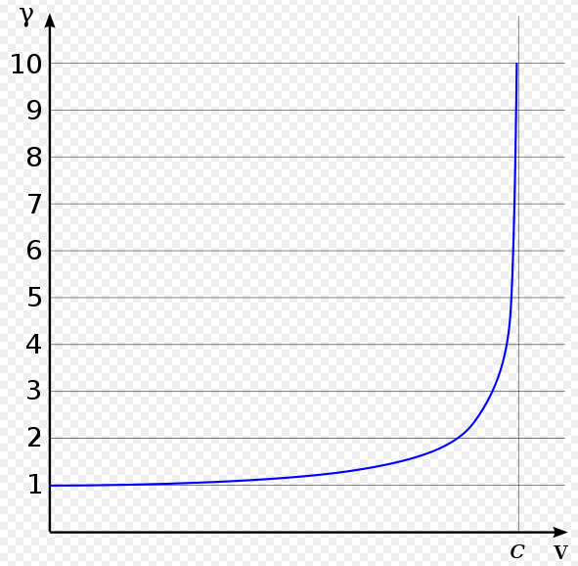
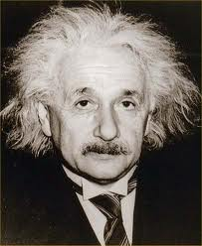
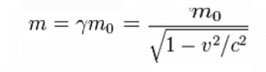
Relativistic Space-Time
Lorentz Factor
Time Dilation
Length Contraction
Relativistic Mass
Near the speed of light: distances are longer, clocks run slower and masses are heavier than the rest mass.

Slide 12
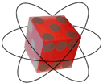
Classical vs. Quantum Bits
Topic | Classical | Quantum
Bits | Binary values 0/1 | Qubits
States | Mutually exclusive | Linearly independ.
Operators | Nand/Nor gates | Matrix Multiply
Reversibility | Toffoli/Fredkin gate | Qubits are unitary
Measurement | Deterministic | Probabilistic
Superposition | Code division mlpx | Mixtures of
Entanglement | none | Ebits

Slide 13
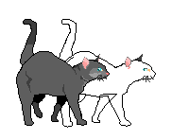
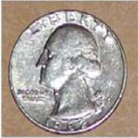
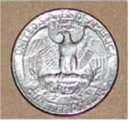
Quantum Bits – Qubits
Classical bit states: Mutual Exclusive
Quantum bit states: Orthogonal
State1
180°
-
spin ½
90°
-
+
State1
State0
+
State0
Classical states co-exclude others
Qubits states are probabilistic

Slide 14
Quantum Space-Time
Qubit (Quantum Bit)
Superposition (q*2 states)
Unitary ops & measurement
Qureg for ≥2 Qubits
Tensor Product (2^{q} states)
for q=200 then 1.6 x 10⁶⁰ states
Ebit for ≥2 Qubits acting as 1
Entanglement
Separated but states act as one
Non-local correlated states (EPR/Bell/Magic)


Slide 15
Quantum Computing Speedup
Peter Shor’s Algorithm in 1994
Quantum Fourier Transform for factoring primes
New quantum polynomial time complexity class
space
space
space
time
time
time
Spatially bound
exceeds universe life
Temporal bound
exceeds black hole
Quantum polynomial
time can solve it.
classical
relativistic
quantum
Solutions to some problems don’t fit in the classical universe!!

Slide 16
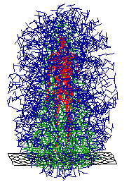
Human Being Space Behaviors
Space oriented behaviors
States as address in high dimensional space
High dim properties as brain/mind mechanism
Brain as high-dimensional transceiver
Nearest similar to holographic mind
Simultaneous observer frames
Remote Viewing
Teleportation & bilocation

Slide 17
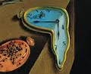
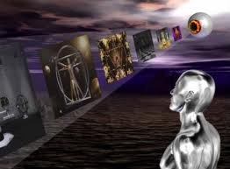
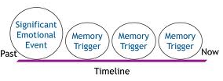
Human Being Time Behaviors
Time oriented behaviors
Living in the ‘Now’
Time slows when in danger or ‘In the zone’
Pre-response for 10,000 pictures experiments
Pre-cognitive Remove Viewing
New Retro-causation research and papers
Remembering the future
Time line techniques →

Slide 18
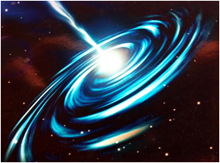
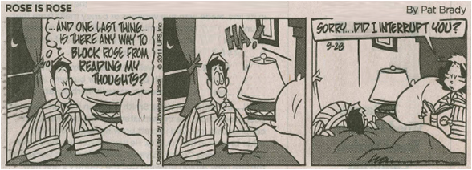
Human Being Information Behaviors
Information/Meaning oriented behaviors
Intuition & Coincidences (knowing future events/danger)
Law of Attraction (meaning based) →
Thoughts and Manifestation
Remove Viewing & Remote Staring
Clairvoyance, NDEs, OBEs
Shared Lucid Dreams
Telepathy →
Channeling
Supermind
Vibration

Slide 19
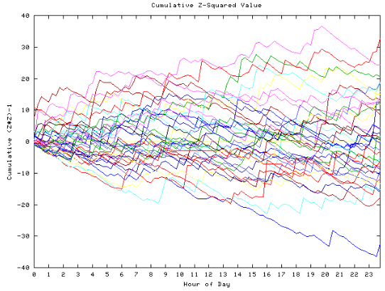
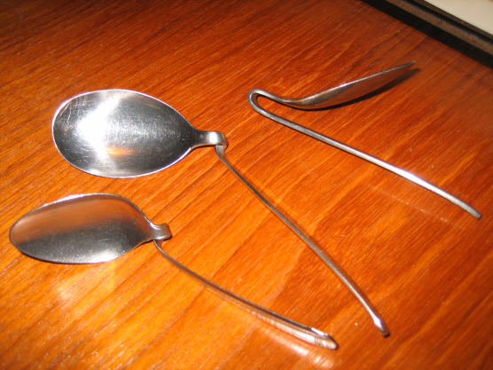
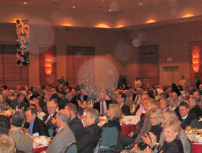
Humans Affecting the Physical World
Physical affects research
Global Consciousness Project (on 9/11) →
Copper Wall
Mind affecting electronics
Spoon Bending →
REG, RNG & PK experiments
Teleporting
Orbs affect cameras →
Manifestation
…

Slide 20
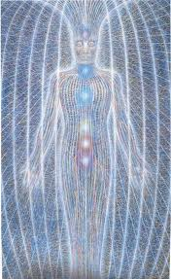
Human Being Energy Behaviors
Subtle Energy/Chi oriented behaviors
Anchoring, squashes, phobia cures & reframing
Grounding, balancing & clearing (QCS)
Breathing and breath works
Reiki and healing sciences
Remote healing
Subtle energy generators
Auras, chakras, meridians, homeopathy,
…

Slide 21
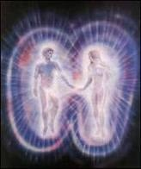
Beings of Light Space-Time
Space oriented behaviors
Vibration without classical metrics
Ubiquitous
Connectedness
Unity and oneness
Collective Beings
Out of Body and Ascension
Time oriented behaviors
Eternal and timelessness (before time itself)
Total experience without sequences/language
Experience different time rates – proto-time
Change/evolution without time

Slide 22
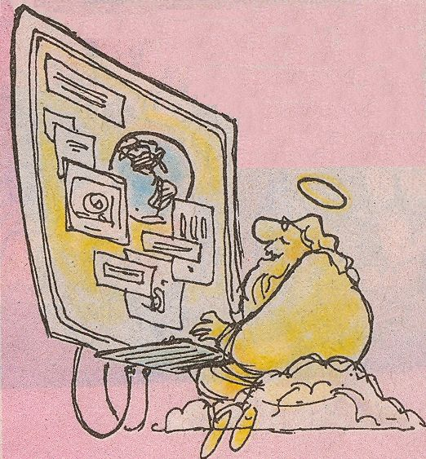
Beings of Light Energy-Info
Information/meaning oriented behaviors
Everything is Awareness, Consciousness & Intelligence
All knowing and direct knowing/remembering
Direct experience without language
Universal Meaning without language
Thought without brain and no-thought
Akashic Records and Master Teachers
Touch the Divine & exceptional experiences
Energy
All Powerful
Emotion is thought amplifier (love, joy, peace, divinity)
Thought/emotions can affect the brain/world
Kundalini awakening, transcendence

Slide 23
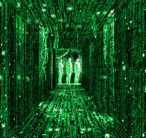
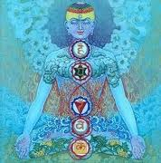
Beings of Light Quantum Summary
Quantum Dimensions (QDs) are root to every ‘thing’:
QDs are more proto-physical than classical space-time
Classical world derived from QDs information properties
Empty Space & Black holes derived from QDs
QDs are information/intelligence and meaning
Light derived from QDs
Beings of Light are collections of ‘intelligent’ QDs
Models of God have evolved

Slide 24
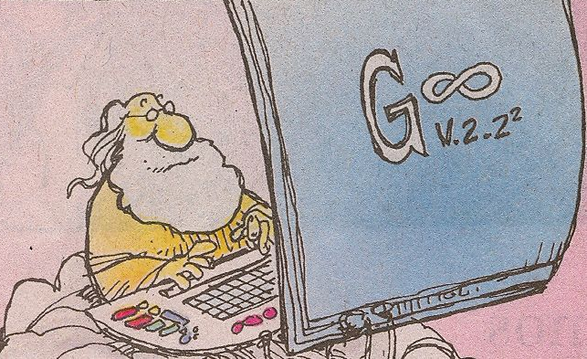
God All Powerful & All Knowing!
What kind of Information did God use to create the big-bang?
Poof
Quantum states = Dimensional Strands
Quantum states: source of the bit-bang (maybe a big thought!)

Slide 25
Questions and Discussion
Possible Discussion Topics:
Knowledge vs. Power
Information vs. Knowing
Light and vibration
Now and Eternity
Life after Life
Angels and God
What is Heaven
…

Slide 26
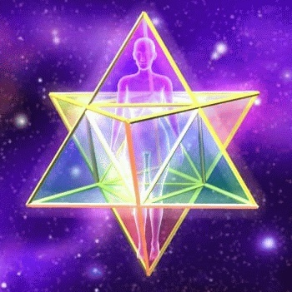
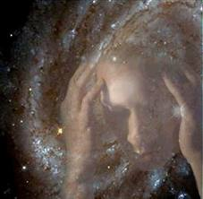
Science of Spiritual Beings Series
Oct 24: Introduction to Science of Spiritual Beings
Oct 31: Science of Law of Attraction
Nov 7: Science of Thoughts, Beliefs, Emotions and Subtle Energy
Nov 14: Science of Daily Living as Spiritual Beings both now and in the future

